Slide 1
Classification of Retailers
File created on: 12/29/2020
Data Analysis in Tableau

Slide 2
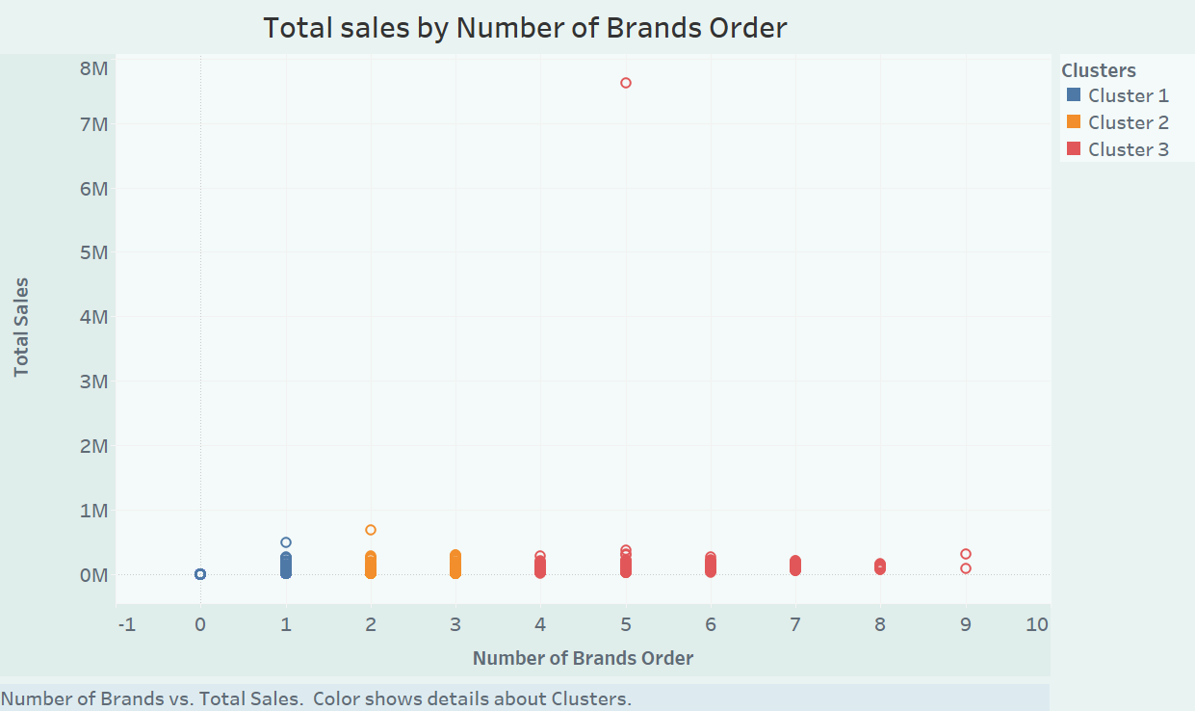

Slide 3
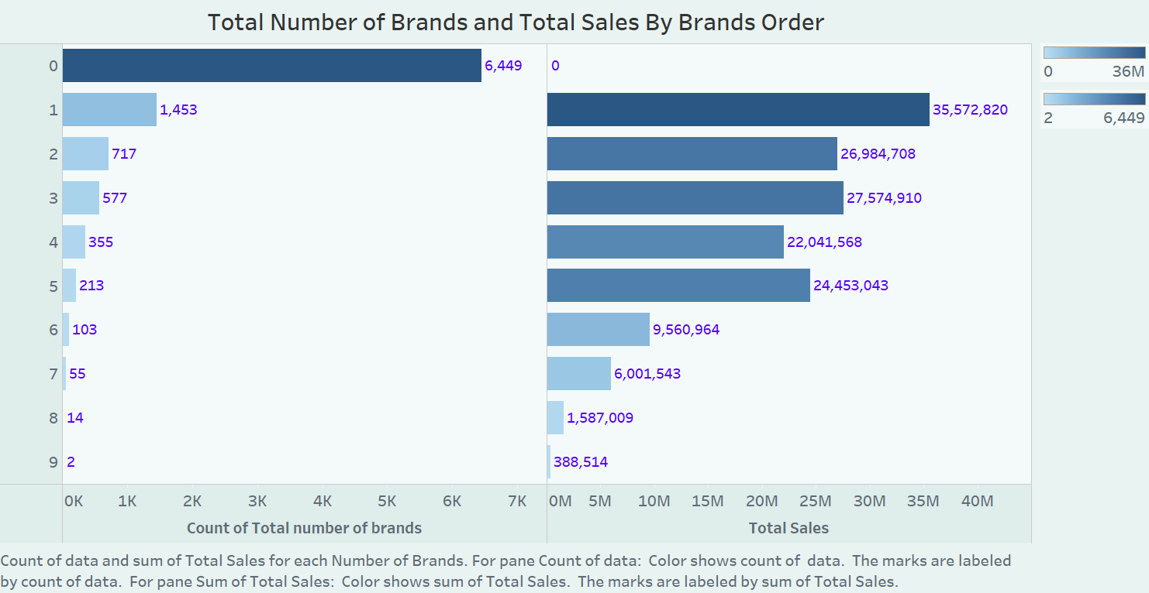

Slide 4
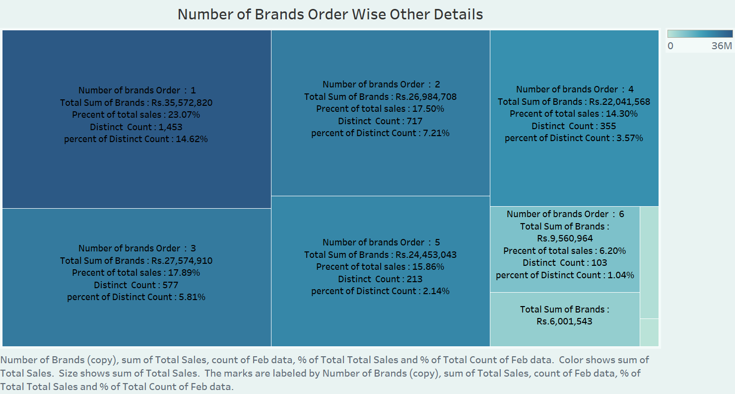

Slide 5
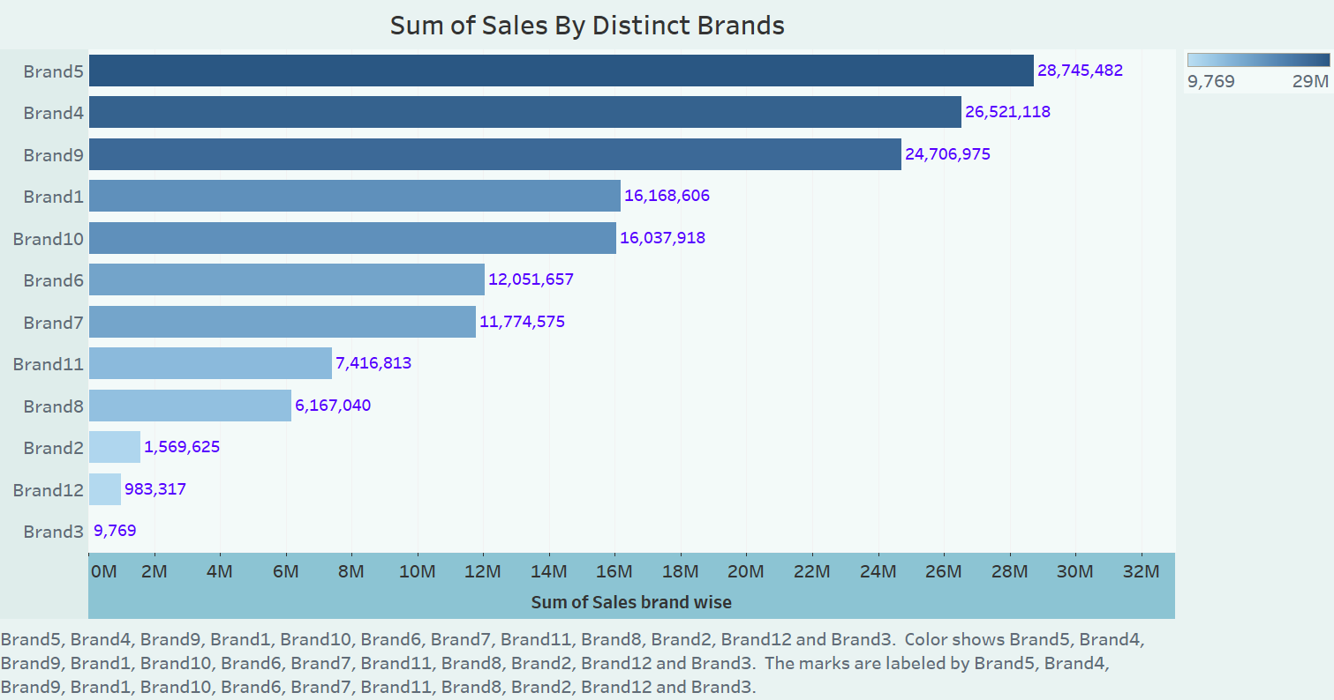

Slide 6
